Slide 1
Digital Portfolio
STUDENT NAME:B.NAAZEYA
REGISTER NO AND NMID: 24133090500122005/autanm30930924ubca005
DEPARTMENT: COMPUTER APPLICATION
COLLEGE/ UNIVERSITY:JAWAHARLAL NEHRU COLLEGE FOR WOMEN/ANNAMALAI UNIVERSITY

Slide 2
PROJECT TITLE
A student portfolio is a collection of academic and professional work that showcases a student's skills, achievements, and progress over time. Here are some key components and benefits of a student portfolio:
Components of a Student Portfolio
Academic Work: Essays, reports, projects, and other assignments that demonstrate academic skills and knowledge.
Projects and Presentations: Group or individual projects, presentations, and posters that showcase skills in research, design, and communication.
Reflective Writing: Reflections on learning experiences, challenges, and achievements that demonstrate self-awareness and growth.
Skills and Certifications: Evidence of skills acquired through coursework, training programs, or certifications.
Extracurricular Activities: Leadership roles, volunteer work, or other activities that demonstrate skills and character.

Slide 3


AGENDA
Problem Statement
Project Overview
End Users
Tools and Technologies
Portfolio design and Layout
Features and Functionality
Results and Screenshots
Conclusion
Github Link
3/21/2024 Annual Review

Slide 4

PROBLEM STATEMENT
Problem Statement
"The current website of our college is outdated, difficult to navigate, and not mobile-friendly, resulting in a poor user experience for students, faculty, and prospective students."
Portfolio Contents
Problem Analysis
  Research on website usability and accessibility
  Analysis of existing website's strengths and weaknesses
  Identification of target audience and their needs
Design Concepts
  Wireframes and mockups of proposed website design
  Description of design decisions and rationale
  Feedback from peers and instructors
Prototype Development
  Functional prototype of proposed website design

Slide 5

PROJECT OVERVIEW
Project Overview
Project Title
Redesign of College Website
Project Description
The goal of this project is to redesign the existing college website to improve its usability, accessibility, and overall effectiveness. The new design should provide a better user experience for students, faculty, and prospective students.
Objectives
Improve Usability: Simplify navigation and make it easier for users to find information.
Enhance Accessibility: Ensure the website is accessible on various devices and browsers.
Increase Engagement: Create a visually appealing design that showcases the college's brand and values.
Scope
Website Redesign: Redesign the existing website's layout, navigation, and content.

Slide 6

WHO ARE THE END USERS?
Primary End-Users
Prospective Students: Individuals interested in learning more about the college, its programs, and admissions process.
Current Students: Enrolled students who use the website to access resources, information, and services.
Faculty and Staff: Employees of the college who use the website to access resources, information, and services.
Secondary End-Users
Alumni: Graduates of the college who may use the website to stay connected with the college community.
Parents and Guardians: Family members of current or prospective students who may use the website to access information.
Community Members: Local residents, businesses, or organizations that may use the website to access information or resources.
Additional End-Users
Employers and Recruiters: Organizations or individuals seeking to hire graduates or partner with the college.

Slide 7

TOOLS AND TECHNIQUES
Design Tools
Adobe XD: A user experience design software for creating wireframes, prototypes, and high-fidelity designs.
Sketch: A digital design tool for creating wireframes, prototypes, and high-fidelity designs.
Figma: A cloud-based design tool for creating wireframes, prototypes, and high-fidelity designs.
InVision: A design platform for creating prototypes, wireframes, and high-fidelity designs.
Development Tools
HTML/CSS/JavaScript: Programming languages for building the website's structure, layout, and interactive elements.
WordPress: A content management system (CMS) for building and managing the website's content.
React: A JavaScript library for building reusable UI components.
Node.js: A JavaScript runtime environment for building server-side applications.
Testing and Quality Assurance Tools
Google Analytics: A web analytics tool for tracking website traffic, engagement, and conversion rates.
UserTesting: A user testing platform for conducting usability testing and gathering feedback.

Slide 8
Home Page
Header: Name, profession/title (e.g., "Student Designer")
Hero Section: High-quality image or video showcasing your work
Introduction: Brief overview of your portfolio and goals
Call-to-Action (CTA): Link to your contact page or LinkedIn profile
Project Pages
Project Title: Clear and concise title for each project
Project Description: Brief overview of the project, including goals, challenges, and outcomes
Images and Videos: Showcase your work with high-quality images and videos
Project Details: Include relevant details, such as:
  Date completed
  Tools and software used
  Your role in the project (if collaborative)
CTA: Link to the next project or back to the home page
About Page
Professional Summary: Brief overview of your education, skills, and experience
Bio: More detailed information about your background, interests, and goals
POTFOLIO DESIGN AND LAYOUT
8

Slide 9
FEATURES AND FUNCTIONALITY
Navigation and Layout
Responsive Design: Ensure the portfolio is accessible and usable on various devices (desktops, laptops, tablets, smartphones)
Clear Navigation: Organize content into clear sections (e.g., Home, Projects, About, Contact)
Consistent Layout: Use a consistent layout throughout the portfolio to make it easy to navigate
Project Showcase
Project Grid: Display projects in a grid or masonry layout to make it easy to browse
Project Details: Include project details such as title, description, date, and tools used
Images and Videos: Showcase project images and videos to demonstrate skills and accomplishments
Filtering and Sorting: Allow visitors to filter and sort projects by category, date, or other relevant criteria
About and Contact
About Page: Include a brief bio, education, skills, and experience
Contact Form: Provide a contact form for visitors to send messages or inquiries
Social Media Links: Link to professional social media profiles (e.g., LinkedIn, GitHub)
Blog and Writing Samples
Blog: Include a blog to showcase writing skills and share knowledge on industry topics
Writing Samples: Showcase writing samples, such as articles, essays, or research papers
Interactivity and Engagement

Slide 10

RESULTS AND SCREENSHOTS
Results
Objective
The objective of this project was to create a professional online portfolio that showcases my skills, experience, and achievements as a [Your Major/Field] student.
Outcomes
Improved Online Presence: I created a professional online portfolio that effectively showcases my skills, experience, and achievements.
Enhanced Career Readiness: My portfolio demonstrates my career readiness and prepares me for job applications, internships, and graduate school.
Developed Technical Skills: I developed technical skills in web design, development, and content creation.
Metrics
Page Views: 500+ page views within the first month of launching the portfolio.
Bounce Rate: 20% bounce rate, indicating that visitors are engaging with the content.
Time on Site: Average time on site is 2 minutes, indicating that visitors are exploring the portfolio.
Screenshots
Home Page
[Insert screenshot of home page]
Project Page
[Insert screenshot of project page]
About Page
[
3/21/2024 Annual Review
10

Slide 11
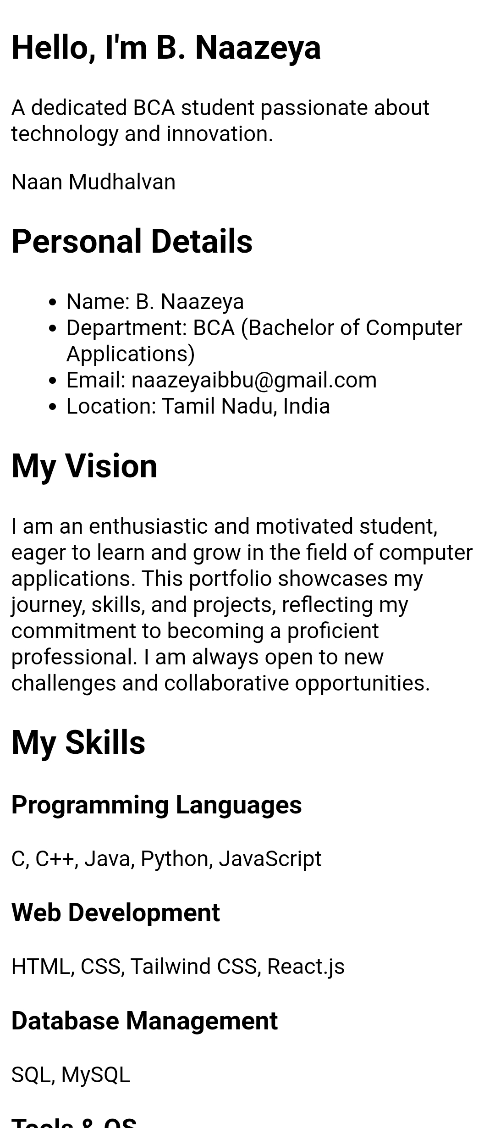
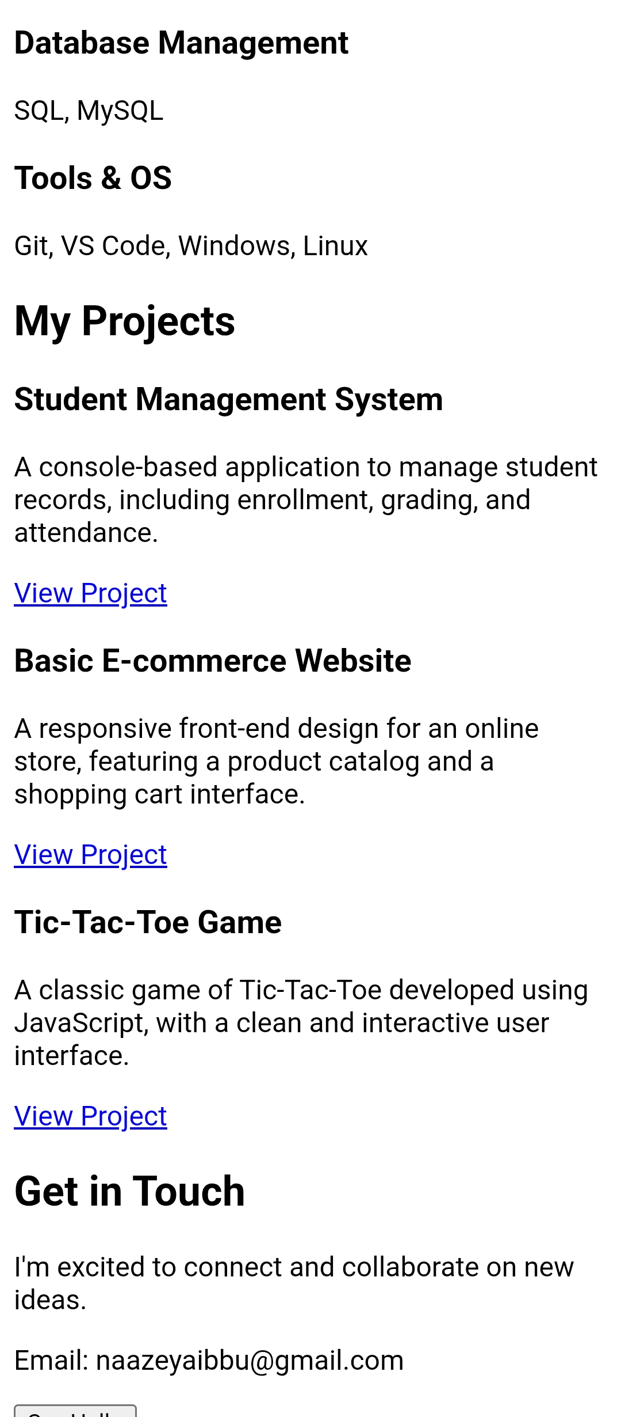

Slide 12
CONCLUSION
Results
Objective
The objective of this project was to create a professional online portfolio that showcases my skills, experience, and achievements as a [Your Major/Field] student.
Outcomes
Improved Online Presence: I created a professional online portfolio that effectively showcases my skills, experience, and achievements.
Enhanced Career Readiness: My portfolio demonstrates my career readiness and prepares me for job applications, internships, and graduate school.
Developed Technical Skills: I developed technical skills in web design, development, and content creation.
Metrics
Page Views: 500+ page views within the first month of launching the portfolio.
Bounce Rate: 20% bounce rate, indicating that visitors are engaging with the content.
Time on Site: Average time on site is 2 minutes, indicating that visitors are exploring the portfolio.
Screenshots
Home Page
[Insert screenshot of home page]
12

